Slide 1

Predicting Inflation with Random Forest
Alex Moran

Slide 2
Outline
Definitions/Concepts
The Project
Tuning Issues
Time-Series Issues
Early Results
Next Steps

Slide 3
Definitions

Slide 4
Definitions: Random Forest
Collection of regression trees

Slide 5
Definitions: Regression Tree
A data modelling technique that splits data into different groups (“leaves”) which are assumed to be similar
Splits performed to minimize the sum of squared errors

Slide 6
Detail: Minimizing SSE

Slide 7
Definitions: Regression Tree
Needs to be tuned somehow
Penalty on splits
Number of leaves
Minimum leaf size

Slide 8



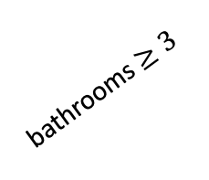
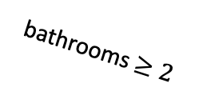
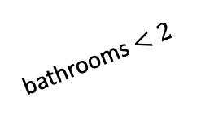
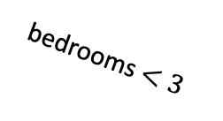
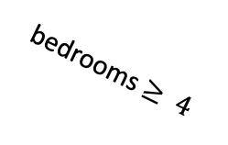
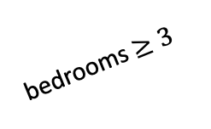
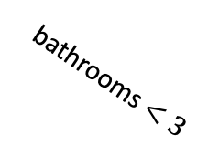
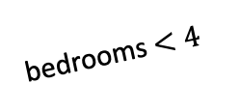
Example: Regression Tree
1x-5x
Avg: $325k
bedrooms $≥3$
10
1x-5x
30
bathrooms $≥3$
bedrooms $<3$
Avg: $250k
20
100
Avg: $125k
bathrooms $<3$
bathrooms $<2$
15
70
bedrooms $<4$
Avg: $175k
bathrooms $≥2$
35
55
bedrooms $≥ 4$
Avg: $300k
20

Slide 9
Definitions: Random Forest
Collection of regression trees
Randomization
Variables
Data
Tuning
Number of trees
% of variables

Slide 10
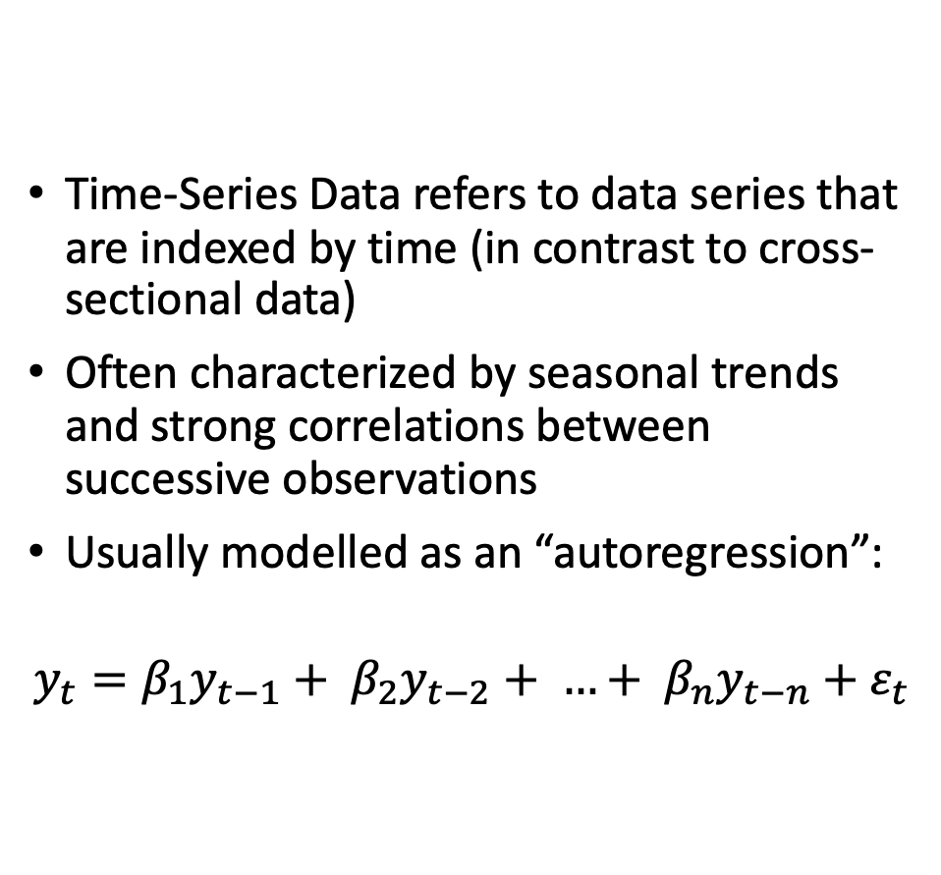
Definitions: Time-Series Data
Time-Series Data refers to data series that are indexed by time (in contrast to cross-sectional data)
Often characterized by seasonal trends and strong correlations between successive observations
Usually modelled as an “autoregression”:
$$y_{t}=β_{1}y_{t−1}+ β_{2}y_{t−2}+ …+ β_{n}y_{t−n}+ε_{t}$$

Slide 11
The Project
Modelling US monthly inflation using a random forest method
Advantages of random forest
Goal: Outperform a standard autoregressive model with a 1-month horizon

Slide 12
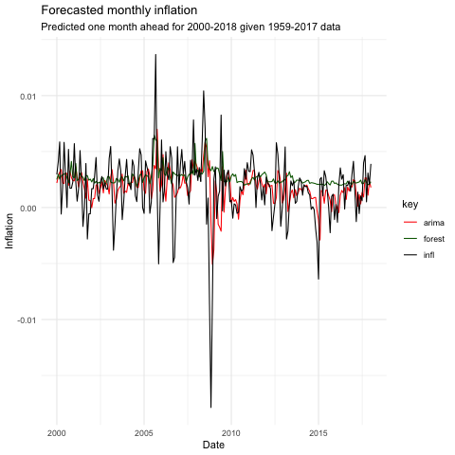
Results
RMSE
Forest: 0.00314665
ARIMA: 0.00291196
MEAN
Forest: 0.002690328
ARIMA: 0.001785547
Actual: 0.001788014

Slide 13
What’s Next?

Slide 14
Tuning Issues
Tuning the tree
Splitting criteria
Tuning the forest
Number of trees
% of variables

Slide 15
Time-Series Issues
Random forest is meant as a cross-sectional method
Treating data as cross-sectional: good or bad?
Correlation worries
Autocorrelation
Residual correlation
Stationarity
Seasonality

Slide 16
Next Steps
Tune the trees for time-series data
Tune the random forest
Replicability (seeding)
Robustness:
Explore results with different horizons
Explore results with different data
Foreign inflation
Unemployment
Exchange rates
etc.

Slide 17
Questions?

